Slide 1
Marketing Campaign Analysis Report
Prediction Product AD Campaign Performance
First Quadrant Lab
Made by Krittika Mukherjee

Slide 2
Agenda
Project Overview
Dataset Description
Key Variables
Analysis Workflow
Insights & Findings
Next Steps

Slide 3
Dataset Description
The dataset contains marketing campaign and product sales information including:
  • Campaign characteristics
  • Product attributes
  • Resource allocation
  • Email performance
  • Pricing & discounts
  • Orders generated

Slide 4
Key Variables
• Limit Inform – Campaign or product restrictions
• Campaign type – Email, social media, print, etc.
• Campaign level – National, regional, local
• Product level – High-end, mid-range, budget
• Resource amount – Total allocated resources
• Hour resources – Labor hours involved
• Email rate – Email delivery/open rate
• Price – Selling price
• Discount rate – Applied discount
• Campaign fee – Cost of the campaign
• Orders – Sales generated

Slide 5
Analysis Workflow
1. Data Loading & Backup
2. Exploratory Data Analysis (EDA)
3. Feature Engineering
4. Statistical Analysis
5. Predictive Modeling
6. Results Interpretation

Slide 6
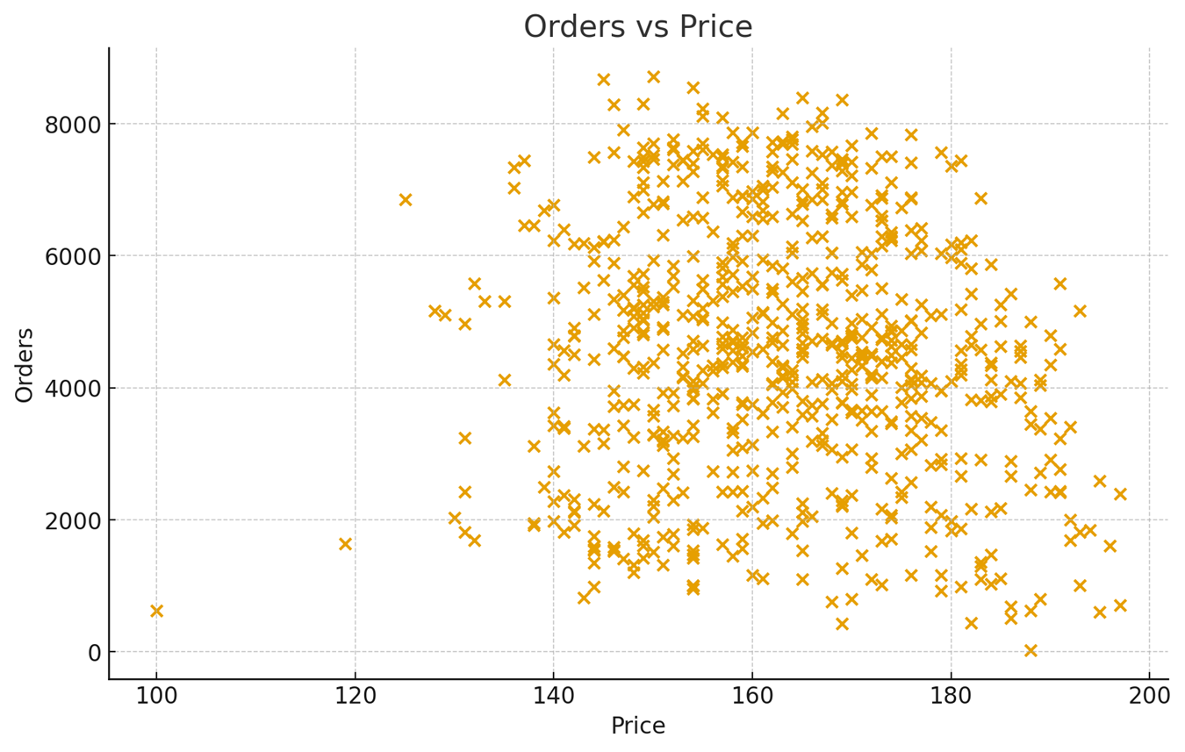
Orders vs Price

Slide 7
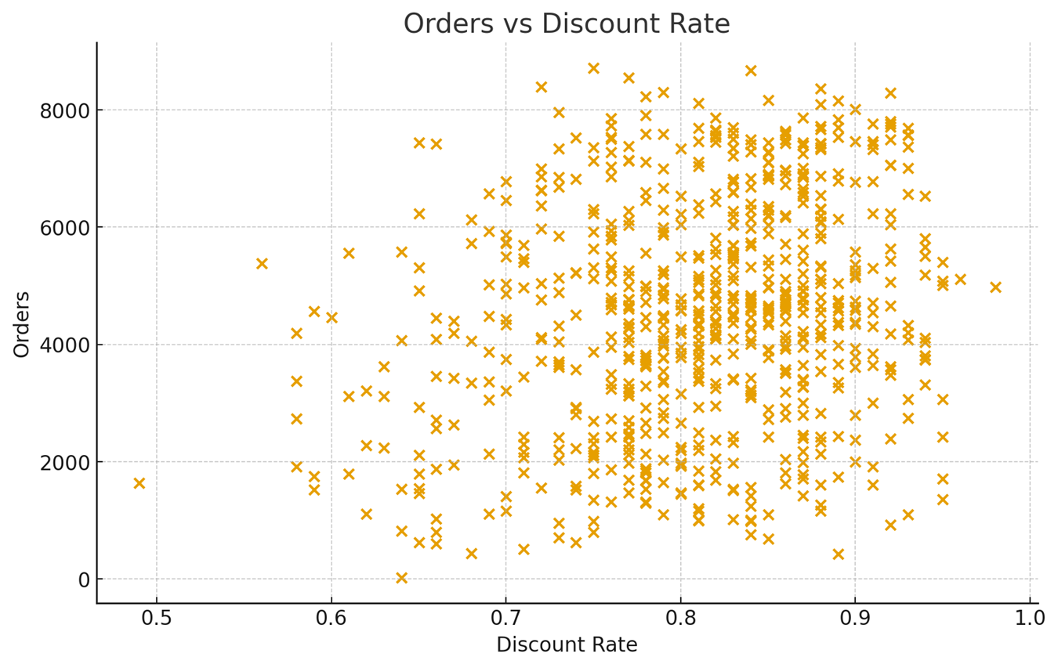
Orders vs Discount Rate

Slide 8
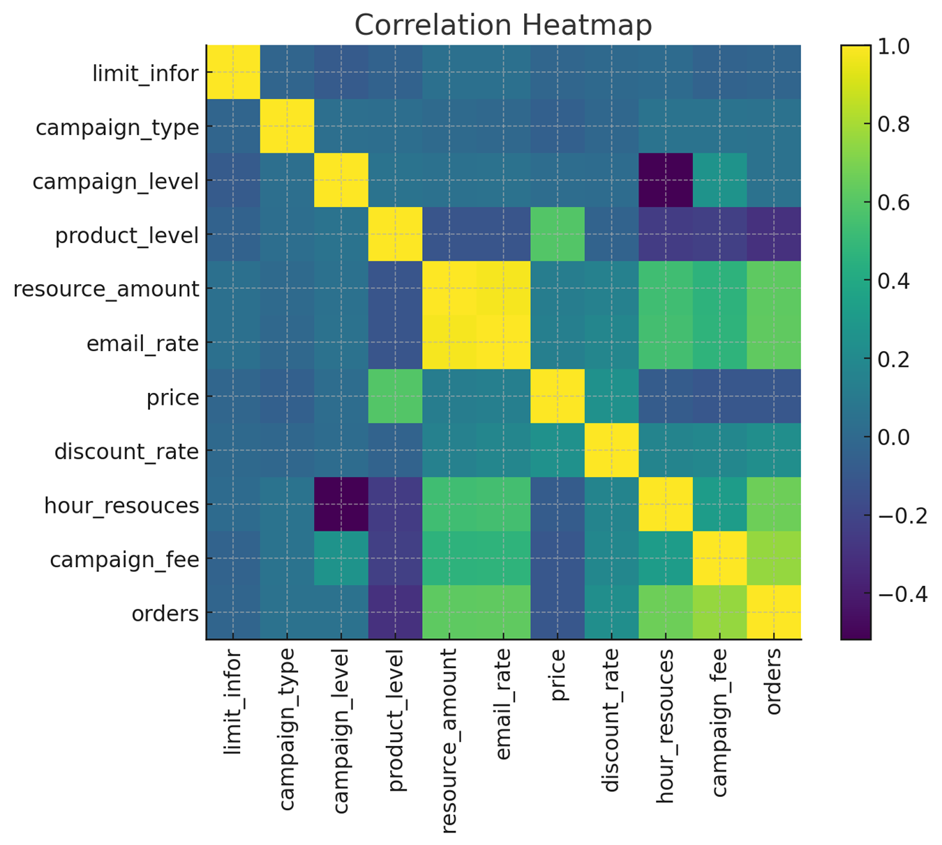
Correlation Heatmap

